Slide 1
Linux iSCSI Storage Target & Initiator

Slide 2
iSCSI Target Software
scsi-target-utils-1.0.24-2.el6.x86_64.rpm
File dependencies:
libibverbs.so.1 (libibverbs, 1.1.8-4.el6)
librdmacm.so.1 (librdmacm, 1.0.19.1-1.1.el6_7)
rdma (6.7_3.15-5.el6)
Remote Direct Memory Access (DMA)
perl (perl-Config-General, 2.52-1.el6)
sg3_utils & sg3_utils-libs (1.28-10.el6_7)
SCSI command utilities

Slide 3
YUM
/etc/yum.conf
/etc/yum.repos.d/CentOS-Base.repo
[base]
name=CentOS-$releasever - Base
mirrorlist=http://mirrorlist.centos.org/?release=$releasever&arch=$basearch&repo=os
gpgcheck=1
gpgkey=file:///etc/pki/rpm-gpg/RPM-GPG-KEY-CentOS-6
[updates]
name=CentOS-$releasever - Updates
mirrorlist=http://mirrorlist.centos.org/?release=$releasever&arch=$basearch&repo=updates
gpgcheck=1
gpgkey=file:///etc/pki/rpm-gpg/RPM-GPG-KEY-CentOS-6

Slide 4
Create an iSCSI Target
Install scsi-target-utils.
# yum install scsi-target-utils
Open port 3260 in the firewall.
# iptables -I INPUT -p tcp -m tcp --dport 3260 -j ACCEPT
# service iptables save
Start and enable the target service.
# service tgtd start
# chkconfig tgtd on
Allocate storage for the LUNs.

Slide 5
Allocate storage for the LUNs
fidks
# fdisk /dev/sdb
/etc/tgt/targets.conf
default-driver iscsi
<target iqn.2016-05.com.example.test:target1>
backing-store /dev/sdb1
initiator-address 10.10.1.1
</target>
Restart target service
service tgtd restart

Slide 6
IQN (iSCSI Qualified Name)
iqn.yyyy-mm.naming-authority:unique name
255 characters
yyyy-mm is the year and month when the naming authority was established.
naming-authority is usually reverse syntax of the Internet domain name of the naming authority.
unique name is any name you want to use, for example, the name of your host.
# cat /etc/iscsi/initiatorname.iscsi
InitiatorName=iqn.1988-12.com.oracle:9a56c487e5af

Slide 7
iSCSI client connection
Allow all initiators
# tgtadm --lld iscsi --mode target --op bind --tid 1 -I ALL
IP-based restrictions
# tgtadm --lld iscsi --mode target --op unbind --tid 1 -I ALL
# tgtadm --lld iscsi --mode target --op bind --tid 1 -I 10.10.0.24
# tgtadm --lld iscsi --mode target --op bind --tid 1 -I 10.10.0.0/24

Slide 8
# tgt-admin --show
Target 1: iqn.2015.06.com.example.test: server
System information:
Driver: iscsi
State: ready
I_T nexus information:
LUN information:
Lun: 0
Type: controller
…
LUN: 1
Type: disk
SCSI ID: IET 00010001
SCSI SN: beaf11
Size: 2147 MB, Block size: 512
Online: Yes
Removable media: No
Prevent removal: No
Readonly: No
Backing store type: rdwr
Backing store path: /dev/sdb1
Backing store flags:
Account information:
ACL information:
10.10.1.1

Slide 9
Create an iSCSI Initiator
Install iscsi-initiator-utils.
# yum install iscsi-initiator-utils
Discover the target.
# iscsiadm -m discovery -t sendtargets -p 192.168.1.1
Connect to the target.
# iscsiadm -m node -T iqn.2015-06.com.example:target1 --login
Find the iSCSI disk name.
# grep "Attached SCSI" /var/log/messages
Create a file system on that disk.
Mount the file system.
# blkid /dev/sdb
/etc/fstab

Slide 10
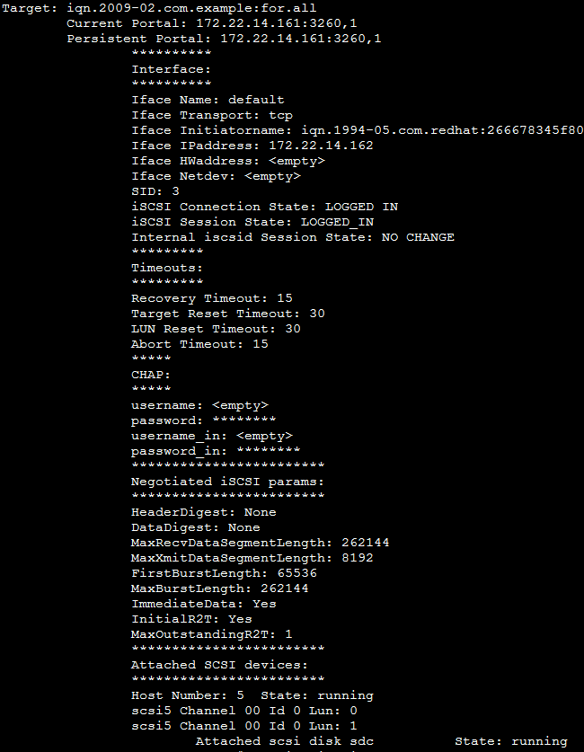
Show iSCSI status
# iscsiadm -m session --op show
tcp: [3] 172.22.14.161:3260,1 iqn.2009-02.com.example:for.all
# service iscsi status

Slide 11
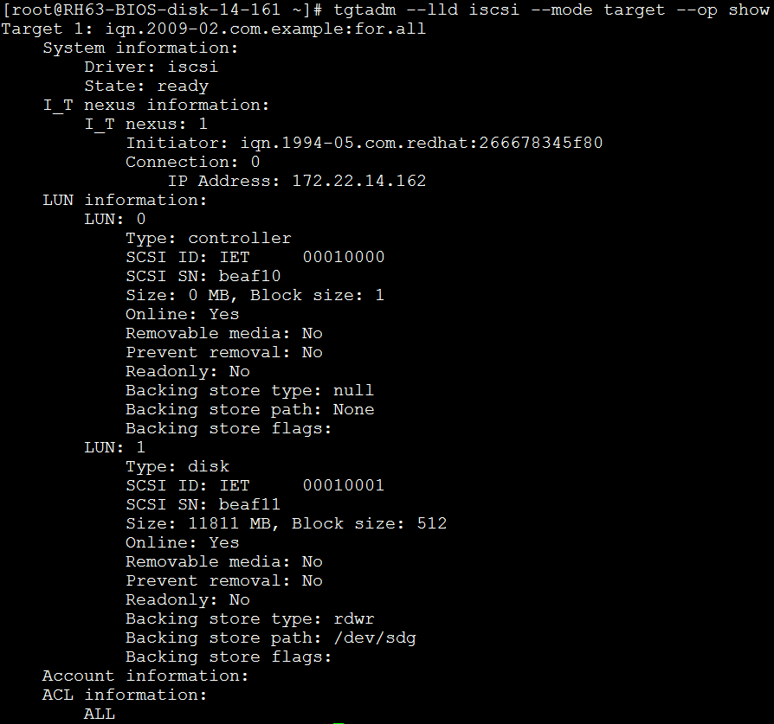
Show target status
# tgtadm --lld iscsi --mode target --op show

Slide 12
Device Naming
/dev/sd name
major:minor number
Device Path (ACSL)
Adapter : Channel : SCSI id : LUN number
By-path identifier (/dev/disk/by-path/)
shortest physical path (according to /sys/block/)
pci-0000:03:00.0-scsi-0:0:0:0-part1 -> ../../sda1
PCI identifier of the host bus adapter (HBA)
channel number on that HBA
the remote SCSI target address
the Logical Unit Number (LUN)

Slide 13
Device Naming cont.
By-label (/dev/disk/by-label/)
/etc/fstab, grub.conf
# e2label <dev> <label>
By-id (/dev/disk/by-id)
World Wide Identifier (WWID)
unique name depending on the hardware serial number
By-uuid (/dev/disk/by-uuid/)
Universally Unique Identifier
blkid
/sbin/scsi_id -g /dev/sda
lsblk -f

Slide 14
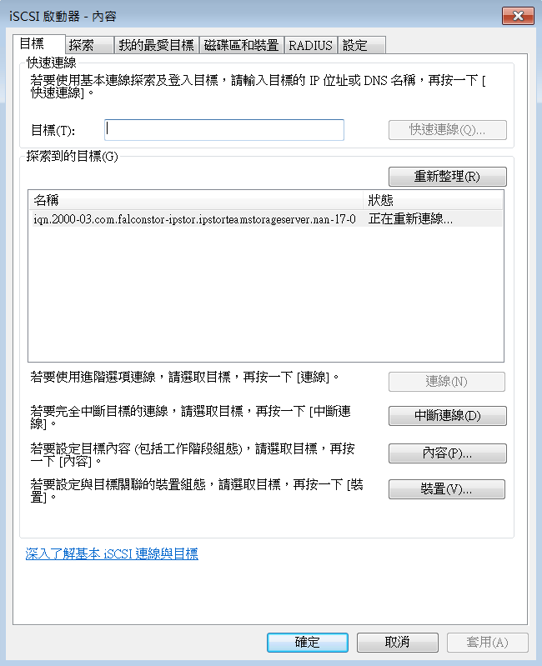
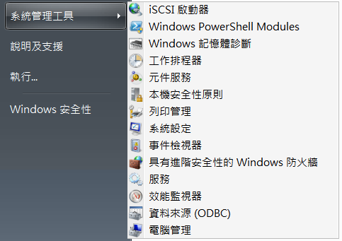
Setup iSCSI Initiator, Windows

Slide 15
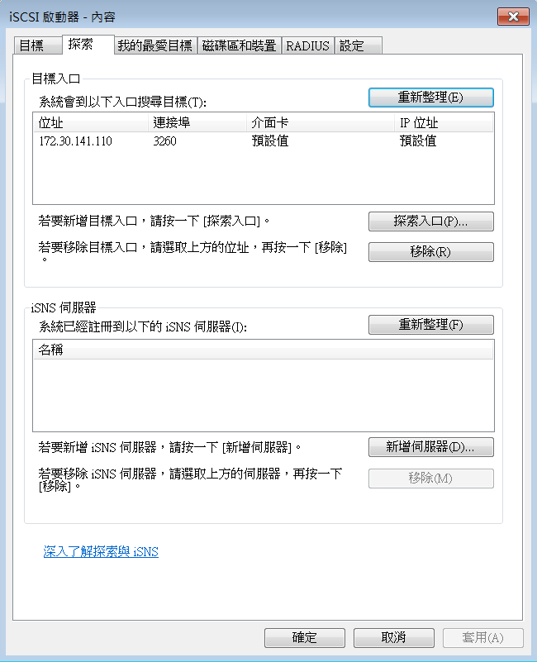
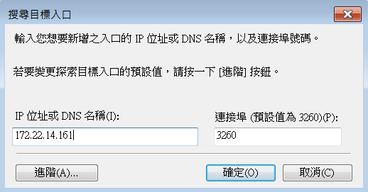
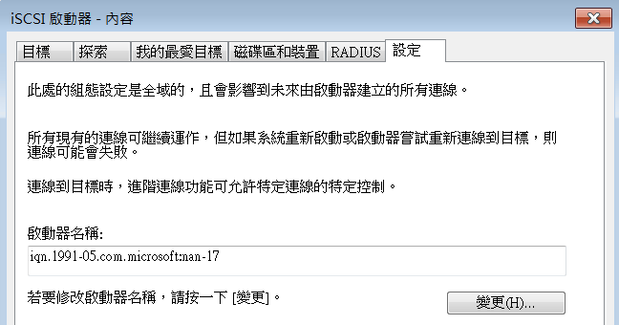
Setup iSCSI Initiator, Windows cont.

Slide 16
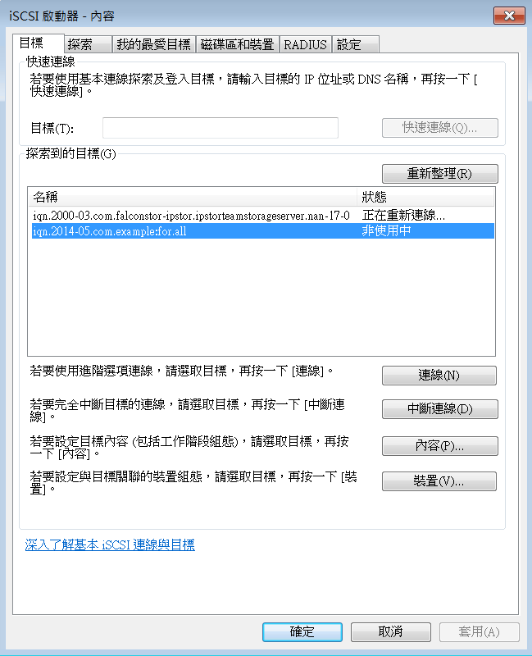
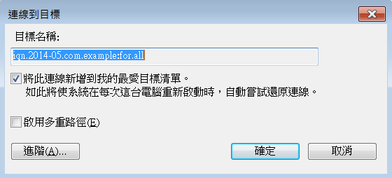
Setup iSCSI Initiator, Windows cont.

Slide 17
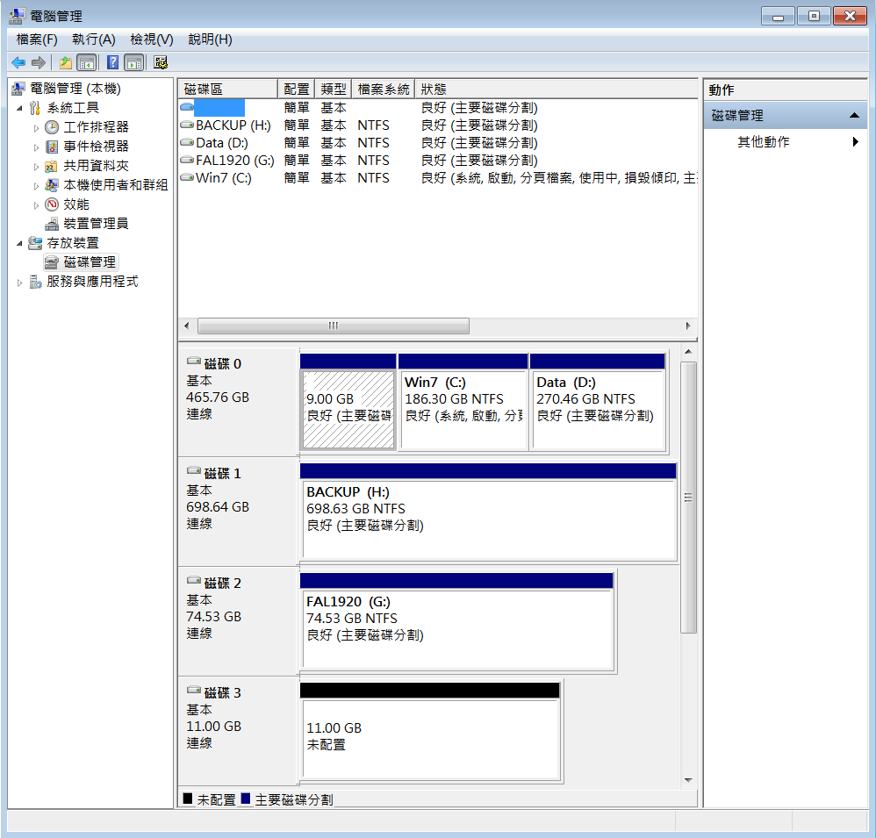
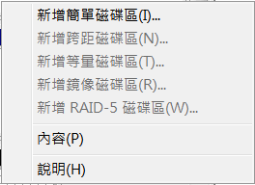
Setup iSCSI Initiator, Windows cont.

Slide 18
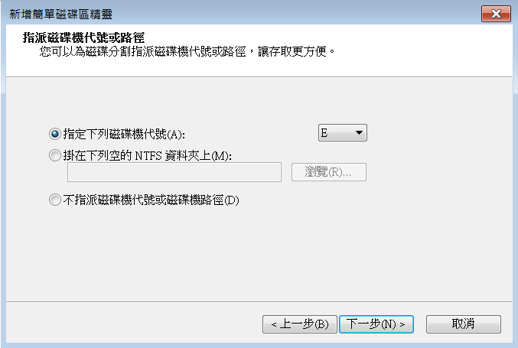
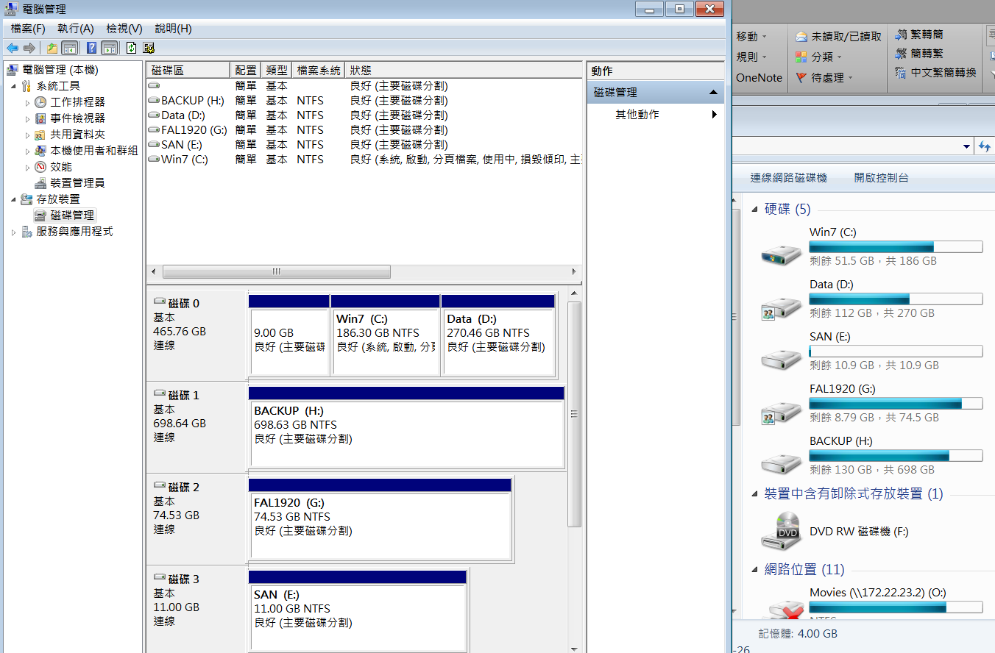
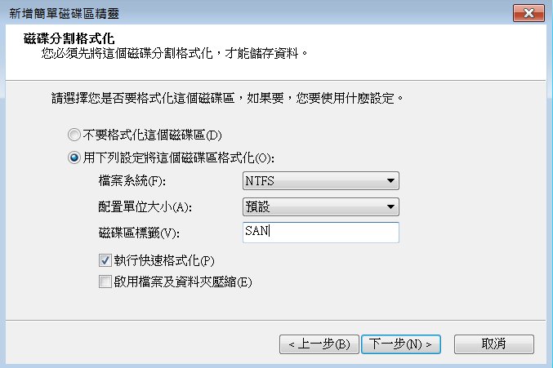
Setup iSCSI Initiator, Windows cont.

Slide 19
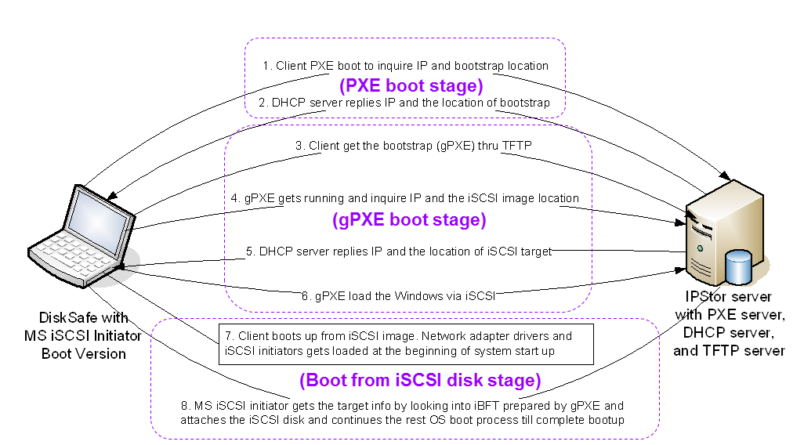
How iSCSI Boot Works

